Slide 1
8255 – Programmable Peripheral Interface

Slide 2
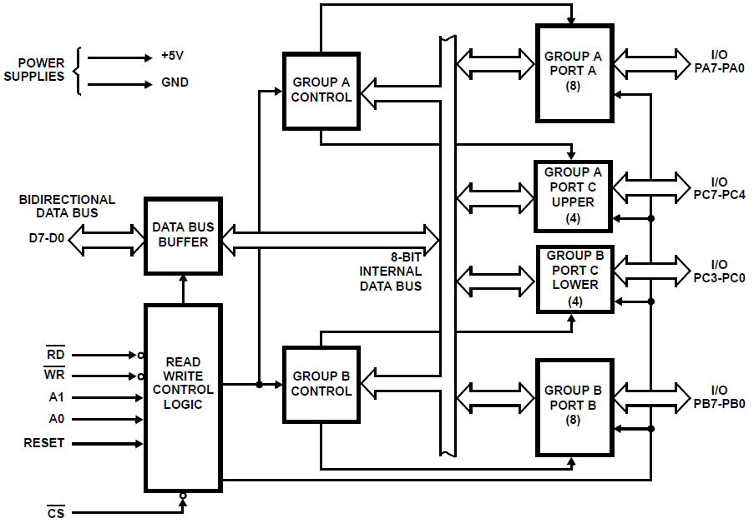

Slide 3
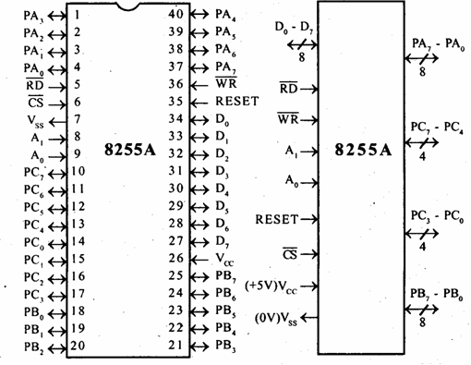
8255

Slide 4
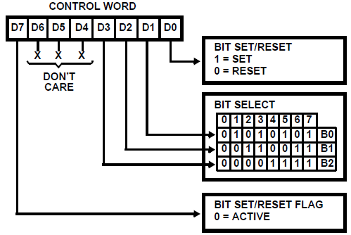
BSR Mode

Slide 5
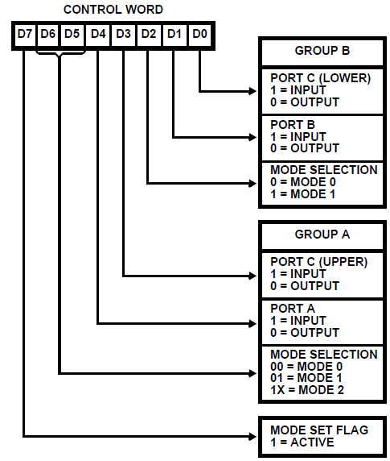

Slide 6
Input Control Signals
STB*: Active low signal
Generated by the peripheral device
Indicates that the input device has transmitted a byte of data into the input buffer
IBF (Input Buffer Full):
Acknowledgement by 8255
Indicates that data has been loaded into the input buffer
Set when STB* input is low and reset when MPU reads the data
INTR (Interrupt Request):
To interrupt MPU when data is ready in the input buffer

Slide 7
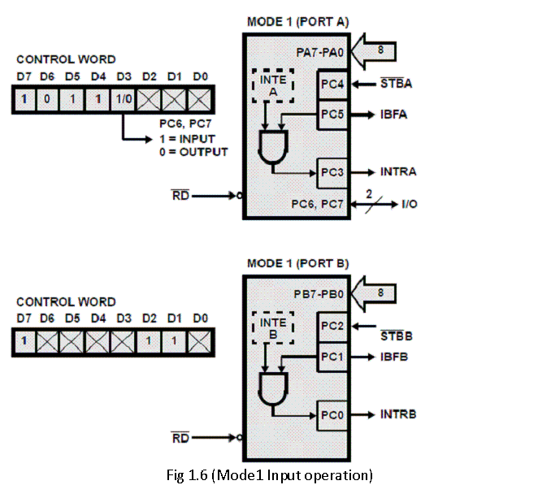

Slide 8
Output Control Signals
OBF* (Output Buffer Full):
Goes low when MPU writes data into the output buffer of 8255
Indicates the output device that new data is ready to be read
Goes high when 8255 receives an acknowledgement from the peripheral
ACK*: Acknowledgement
Generated by the peripheral device
Indicates that the data from port A or port B is ready to be accepted
INTR (Interrupt Request):
To interrupt MPU when output device has accepted the data transmitted by the MPU
To request the next data byte for output

Slide 9
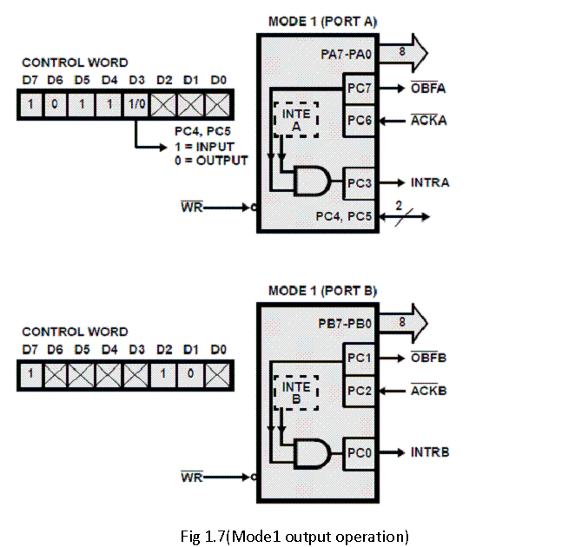

Slide 10
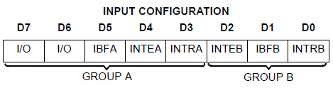
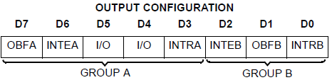
Mode 1 Status Word Format

Slide 11
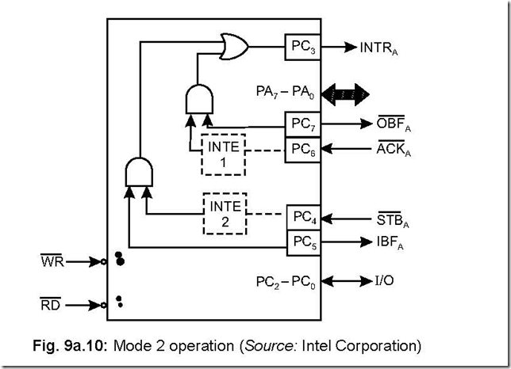

Slide 12

Mode 2 Status Word Format

Slide 13
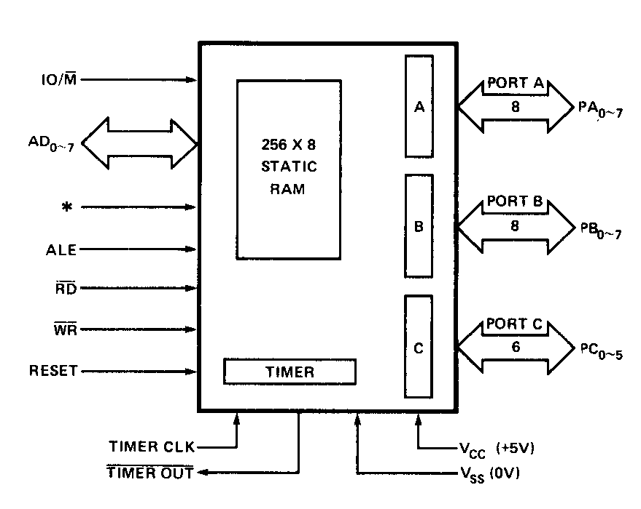
8155

Slide 14
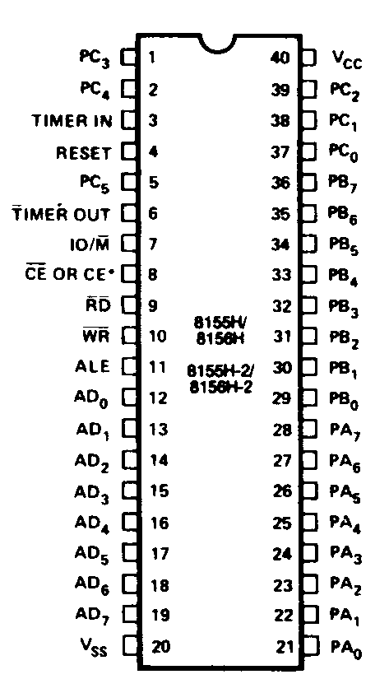
8155

Slide 15
Thank You

